Slide 1
Preparing your Research Proposal Budget & Budget Justification
November 8, 2016
Research Brown Bag Presentation
Kyle Bryan & Muriel Industrious

Slide 2
Where do I begin?
The Funding Solicitation
RFAs: Research Funding Announcements
RFPs: Request for Proposals
PAs: Program Announcements
FOAs: Funding Opportunity Announcements
The solicitation will provide the proposal guidelines
Type of budget to use (there may be an agency specific template)
Costs limitations (direct vs. indirect)
Budgetary restrictions

Slide 3
Types of Budgets
Modular vs. Itemized/Detailed
Modular: simplified, requests are in lump sums of $25,000 modules
Itemized: line-item detail is provided for each year of the project

Slide 4
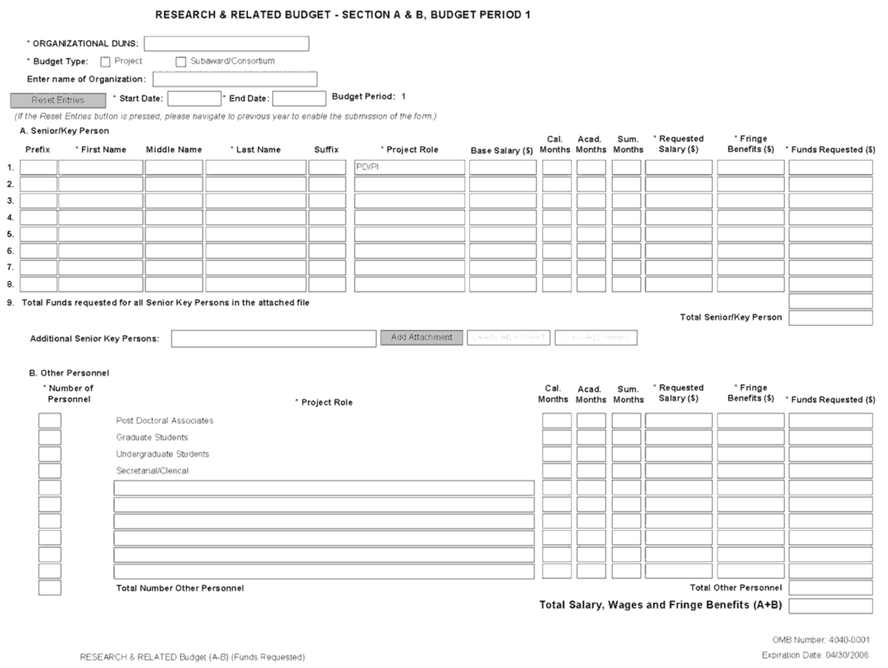

Slide 5
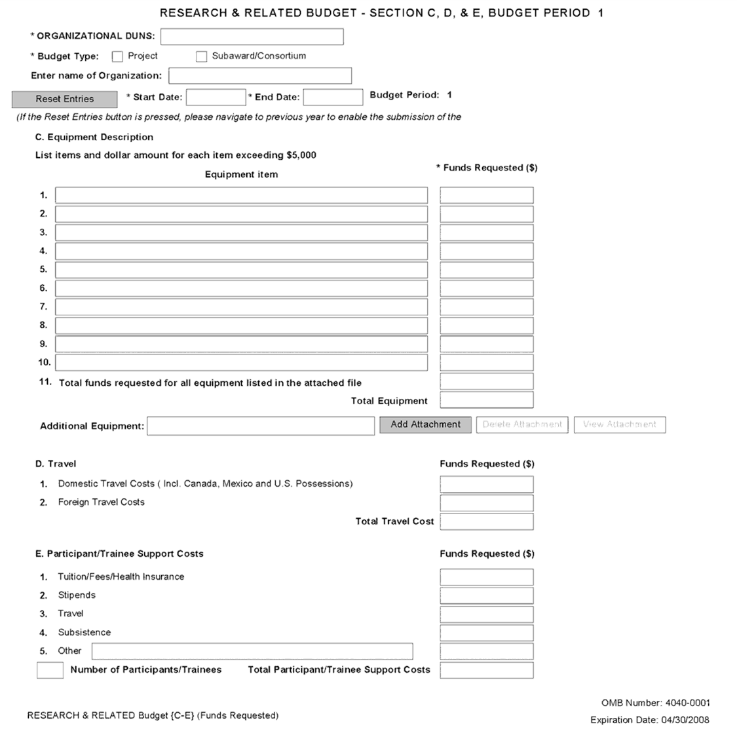

Slide 6
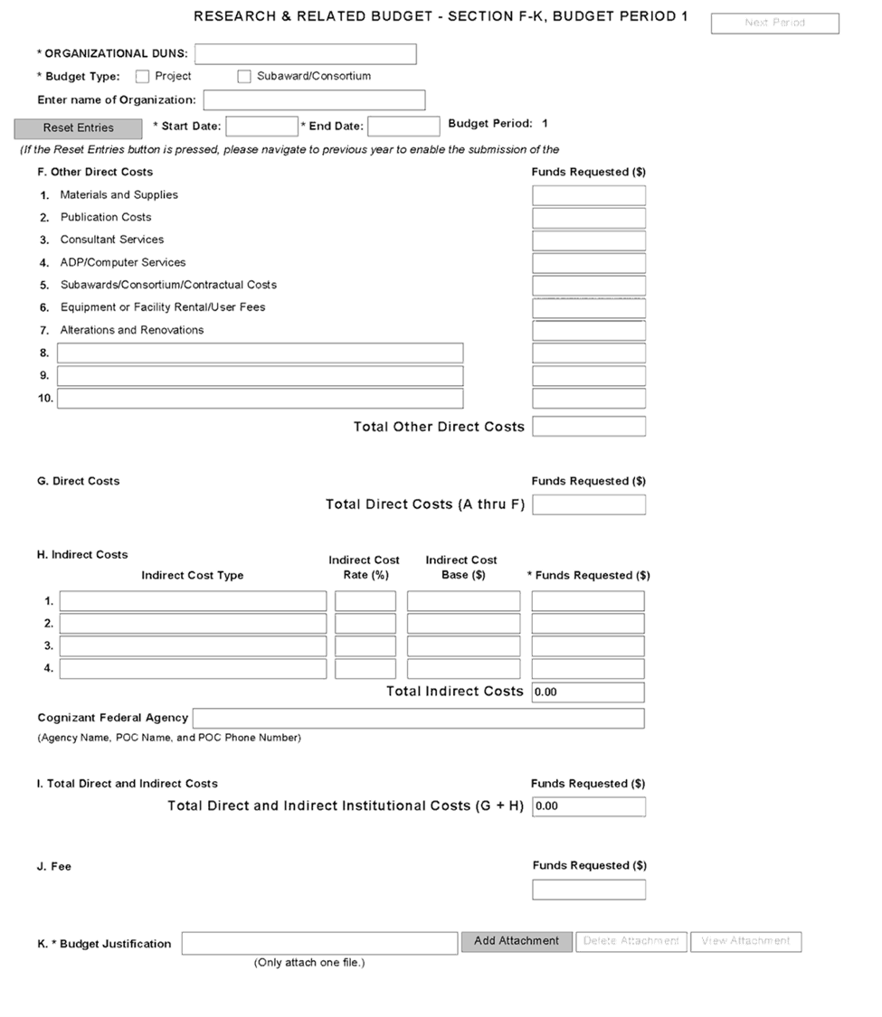

Slide 7
Costs Limitations
Direct costs: are costs that can be identified specifically with a particular sponsored project, an instructional or institutional activity, or one that can be directly assigned to such activities relatively easily with a high degree of accuracy. These costs include expenditures for project personnel salaries and employee benefits, supplies, travel, equipment, telephones, and postage. All direct cost items must be included in the budget.
Indirect costs: are incurred by a grantee that cannot be identified specifically with a particular project or program. They include the costs of many services the college provides (procurement, administrative, library, OSP, Technology Transfer Office (TTO), custodial, accounting/finance, and security) as well as building maintenance and depreciation, and utilities. These costs are often referred to as the “cost of doing business”, business overhead, or Facilities and Administrative Costs (F&A).

Slide 8
Budgetary Restrictions
The funding solicitation will provide information on what costs are can be included in the budget.
The basic considerations for determining the allowability of costs are that they be ALLOWABLE, ALLOCABLE, and REASONABLE:
Allowable refers to costs that may be charged to a grant or contract.
Allocable refers to costs that are necessary for the success of the project.
Reasonable refers to actions a prudent business person would employ.

Slide 9
Examples…
Allowable costs:
Personnel salary and fringe benefits (senior/key personnel, other personnel)
Definition of Key Personnel: “Key personnel are defined as all individuals who contribute in a substantive way to the scientific development or execution of the project, whether or not salaries are requested. Typically, these individuals have doctoral or other professional degrees, although individuals at the masters or baccalaureate level should be included if their involvement meets the definition of key personnel.”

Slide 10
Examples of Allowable Costs (cont.)
Equipment: (capital equipment considered greater than $5,000)
Research Recruitment: gift cards
Travel: professional meeting/conference, mileage
Consultants
Translation/Transcription
IT: iPad, laptops, software
Subcontract/Consortium
Tuition
Meetings

Slide 11
Examples of Unallowable Costs
First class and international travel
Alcohol
Entertainment
Advertising not directly related to research
Construction
Moving expenses
Office furniture
Personal memberships

Slide 12
Purpose and Importance of a Budget
Key element of most grant proposals
Serves as a blueprint for spending the project’s funds
Accurate assessment of all costs that are deemed necessary and reasonable
Helps reviewers determine how the project will be conducted
Budget details usually reveal whether a proposed project has been carefully planned and may ultimately be feasible.
Integral part of the obligation to the sponsor
Particularly regarding time/effort commitments

Slide 13
How is the budget used by Reviewers and Program Officials?
The budget reveals the applicant’s understanding of what it takes to accomplish the proposed research
However, the budget is not used to assess scientific merit and is reviewed after the scientific merit is assessed
RULE 1: Develop a Realistic Budget!
RULE 2: Justify Needs!

Slide 14
Writing a Budget Justification
Most sponsors require you to submit a budget justification, also called a budget narrative
Allows you to explain the need for each line item in the budget
Shows the breakdown of calculations used to arrive at amounts included in the budget

Slide 15
Helpful Tips
When constructing a budget justification, follow the same order as that in the itemized budget or sponsor's budget form, so reviewers can easily compare the two documents.
Check to see if the sponsor limits the page length for the justification.
Be sure everything in your budget and budget justification is referenced in the proposal description/narrative as well—and be sure everything mentioned in your proposal description that would incur cost is explained in the budget and budget justification!

Slide 16
Budget Life Cycle

Slide 17
Any Questions?

