Slide 1
Statistics 101: The 95% Rule
David Newman, PhD

Slide 2
Levels of Data
Nominal
Ordinal
Interval
Ratio
Binary--- The Magic Variable
Categorical
Continuous

Slide 3
Questions To Ask
Are you testing the differences between groups or across time?
T-test (Independent and paired sample) / ANOVA (ANCOVA, RM ANOVA)
Are you testing relationships between variables?
Correlations/ Multiple Linear Regression
How many dependent variables (DV)?
1= Univariate/ 2= Multivariate
How many independent variables (IV)?
T-test Vs ANOVA and Correlation Vs Multiple Linear Regression
What is the level of data for the DV & IV
Paramedic Vs Nonparametric

Slide 5
Converting to r
Calculating Effect Size in Terms of r from Various Test of Statistical Significances
Note. χ² = chi-square. N = sample size. df = degrees of freedom.
Test of Significance | Effect Size r
χ² | (χ²/(χ²+N))^{1/2}
Z | z/N^{1/2}
t | (t²/(t²+(n₁+n₂-2)))^{1/2}
F | r=(F*df_{n}/(F*df_{n}+df_{d}))^{1/2}

Slide 6
The Only Fromula You Need
Y=β0 + β1(Predictor 1) + β2(Predictor 2) … βn(Predictor n) + e
Y=mx+b

Slide 7
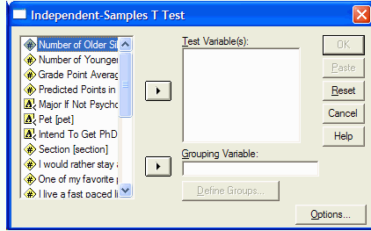
Independent t-test

Slide 8
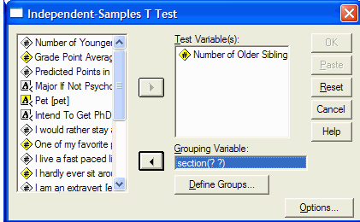
Independent t-test

Slide 9
Independent t-test
Not significant So equal variance assumed
t(44)=-1.46
t-test was not significant p=.151 (t-tailed)

Slide 10
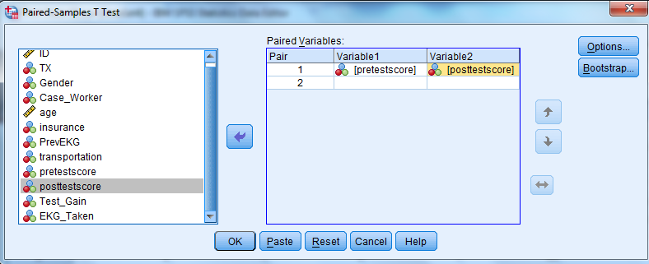
Paired Sample t-test (Dependent)

Slide 11
Paired Sample t-test 3
Significant correlation.
Mean Difference from
T(75)=-12.212
p<.001

Slide 12
Paired Sample t-test 2
Significant correlation.
Mean Difference from

Slide 13
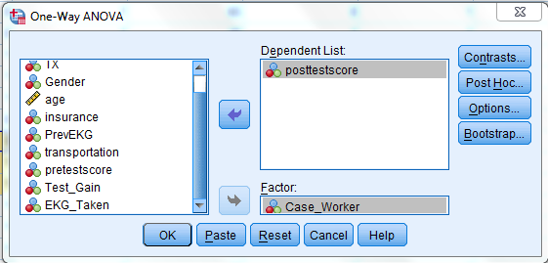
ANOVA (1_Way)

Slide 14
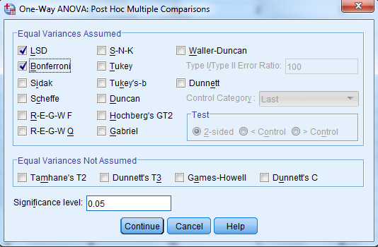
ANOVA - 2
Click on Post Hoc…
Select LSD & Bonferroni

Slide 15
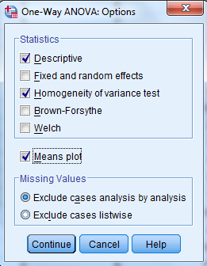
ANOVA - 3
Click on Options

Slide 16
ANOVA -4
Click OK

Slide 17
ANOVA-5
Non-significant Levene’s test for equal variances… GOOD
Statistically Significant [F(2,73)=17.95, p<.001]
But which Caseworkers are significantly different?

Slide 18
ANOVA-6
CW 1< CW 2, CW 1 < CW 3, CW2> CW 3

Slide 19
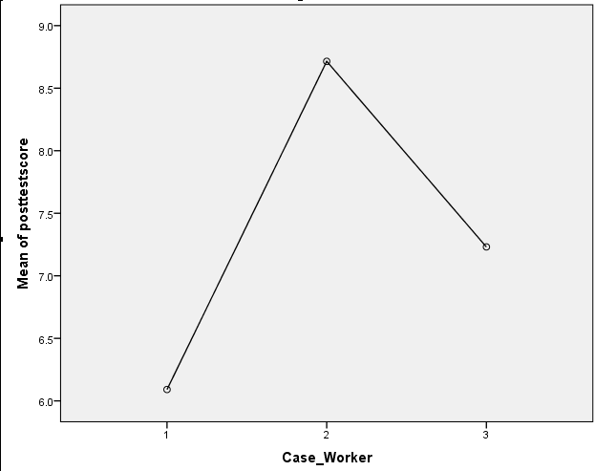
ANOVA 7

